Slide 1


Department of Computer Science and Engineering (Data Science)
LOGO DETECTION and BRAND RECOGNITION SYSTEM
USING AI and REAL-TIME IMAGE PROCESSING
Batch No: 07
S.Rishi Rupak (239P1A6724)
M.Karthik (239P1A6719)
I.Sathwik Reddy (239P1A6704)
M.Shiva Rama Krishna (239P1A6732)
Under the Guidance of
Ms.Farhana
Assistant Professor
Department of Computer Science and Engineering

Slide 2
OUTLINE
Title Of The Project
Abstract
Introduction
Literature Survey
Existing System
Proposed System
Module Split –Up
References

Slide 3
LOGO DETECTION AND BRAND RECOGNITION SYSTEM USING AI AND REAL-TIME IMAGE PROCESSING
“Logo Detection And Brand Recognition System Using Ai And Real-time Image Processing To Detect Logos In Visual Data And Classify Them By Matching Features With A Trained Brand Database”

Slide 4
ABSTRACT
This project proposes an AI-based Logo Detection and Brand Recognition System using deep learning techniques. Convolutional Neural Networks (CNNs) and object detection models are used to detect and classify logos from images and real-time video streams. The system automatically extracts visual features, eliminating the need for manual or rule-based methods. It performs robustly under varying conditions such as changes in scale, orientation, and lighting. Real-time image processing enables fast and accurate recognition for live camera feeds. The system is useful for brand monitoring, copyright enforcement, and digital media analytics.

Slide 5
INTRODUCTION
Logos are a crucial part of brand identity, and detecting them accurately in various media formats is essential for marketing, copyright enforcement, and counterfeit detection. Traditional logo recognition approaches depend on template matching and feature-based extraction, which often fail under varying lighting, occlusions, and transformations.
AI-powered logo detection leverages deep learning models to analyze images and videos, enabling real-time logo recognition with high precision. CNNs and object detection frameworks such as YOLO and Faster R-CNN improve accuracy in detecting logos across diverse backgrounds and conditions.

Slide 6
INTRODUCTION
This project aims to develop an AI-driven system for real-time logo detection that processes image data, identifies brand logos, and categorizes them efficiently. The system integrates deep learning-based feature extraction, real-time image processing, and automated classification to enhance brand monitoring capabilities.
By adopting AI-driven logo detection, businesses, law enforcement agencies, and marketers can efficiently track brand usage, detect counterfeiting, and improve digital marketing strategies.

Slide 7
LITERATURE SURVEY
S.No | Authors & Year | Title | Result
1 | Brown, T., & White, M. (2019) | Deep Learning for OCR-Based Text Recognition | This study explores CNN-based architectures for accurate text extraction.
2 | Singh, R., & Patel, K. (2020) | AI-Powered Language Translation in Smart Applications | The research discusses AI-driven text conversion techniques.
3 | Nguyen, L., & Sharma, P. (2021) | Computer Vision for Signboard Recognition and Text Processing | This paper evaluates OCR models for extracting multilingual text from real-world images.
4 | Martinez, D., & Johnson, S. (2022) | Transformer Models for Context-Aware Language Translation | The authors present deep learning solutions for real-time translation.
5 | Garcia, H., & Lewis, F. (2023) | Enhancing Travel Assistance with AI-Powered OCR and NLP | This study examines AI applications in text recognition for accessibility.

Slide 8
EXISTING SYSTEM
Traditional logo detection systems rely on:
Template matching techniques, which fail under occlusions and transformations.
Manual verification, which is labor-intensive and inefficient for large-scale analysis.
Rule-based feature extraction, which struggles with diverse logo variations.
Limited scalability for real-time brand monitoring in digital media.

Slide 9
PROPOSED SYSTEM
The proposed AI-based logo detection system integrates deep learning and computer vision for improved accuracy and scalability. Key advantages include:
AI-powered feature extraction for high-precision logo detection.
Real-time logo recognition for automated brand monitoring.
Robust detection under varying lighting, occlusions, and image distortions.
Scalable architecture for deployment in digital media, e-commerce, and surveillance.

Slide 10
MODULE SPLIT –UP
Image Acquisition and Preprocessing Module: Captures and enhances input images for analysis.
Deep Learning-Based Feature Extraction Module: Uses CNNs and object detection models to detect logos.
Classification and Brand Recognition Module: Identifies and categorizes logos with high precision.
Data Storage and Analysis Module: Stores detected logo data for tracking and analytics.
Dashboard and Visualization Module: Provides real-time monitoring and brand exposure analysis.

Slide 11
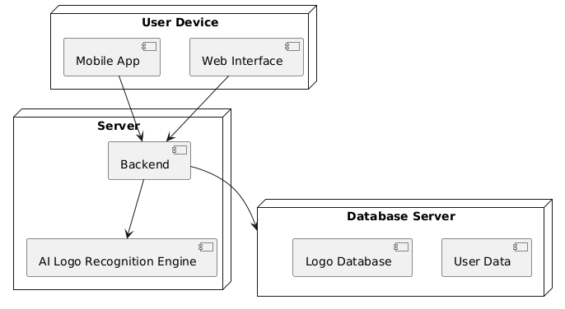
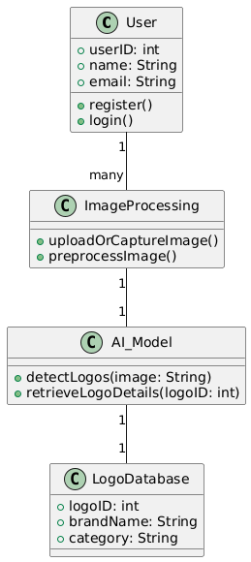
FIG: System Architecture
FIG: Class Diagram

Slide 12
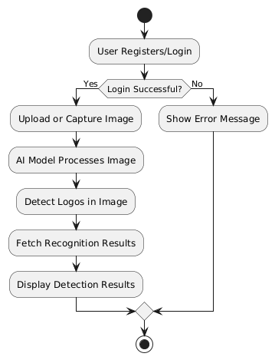
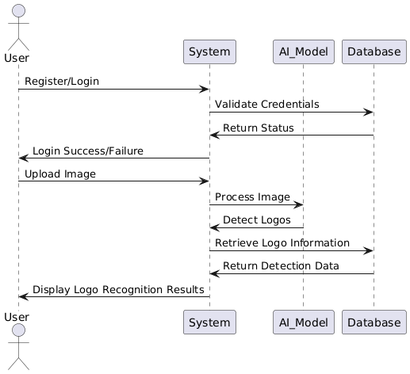
FIG: Activity Diagram
FIG: Squence Diagram

Slide 13
REFERENCE
Brown, T., & White, M. (2019). "Deep Learning for Brand Logo Recognition in Digital Media." This study explores CNN-based architectures for automated logo detection.
Singh, R., & Patel, K. (2020). "AI-Powered Image Recognition for Trademark Protection." The research discusses AI-driven techniques for identifying logos in online content.
Nguyen, L., & Sharma, P. (2021). "Real-Time Object Detection for Brand Monitoring." This paper evaluates deep learning models for detecting logos in real-world environments.

Slide 14
REFERENCE
Martinez, D., & Johnson, S. (2022). "AI-Based Visual Recognition for Counterfeit Detection." The authors present AI-driven solutions for brand protection using image recognition.
Garcia, H., & Lewis, F. (2023). "Enhancing Marketing Analytics with AI-Powered Logo Detection." This study examines AI applications in tracking brand exposure.
Chen, W., & Roberts, L. (2023). "Edge Computing for AI-Based Real-Time Logo Recognition." The paper explores AI-powered recognition models deployed on cloud and edge devices.

Slide 15
QUERIES ??

Slide 16
THANK YOU

